Slide 1
Gog and magog
'Thus says the Lord GOD, "Behold, I am against you, O Gog… (38:3)

Slide 2
Ezekiel 38-39 overview
If taken literally, these chapters seem to indicate that at some point in the future (of Ezekiel’s time) the territory of God’s people would be invaded by hordes from the north.
Ezekiel 38 focuses on the foe that will come against God’s people.
Ezekiel 39 focuses on the results of the victory over Gog.

Slide 3
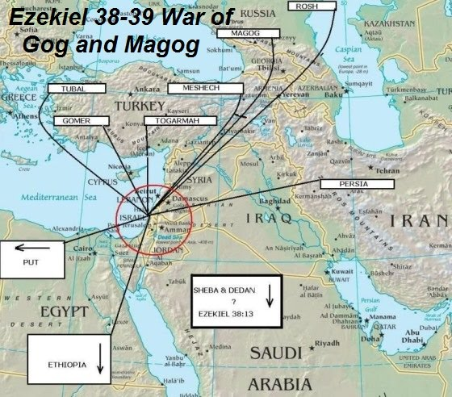
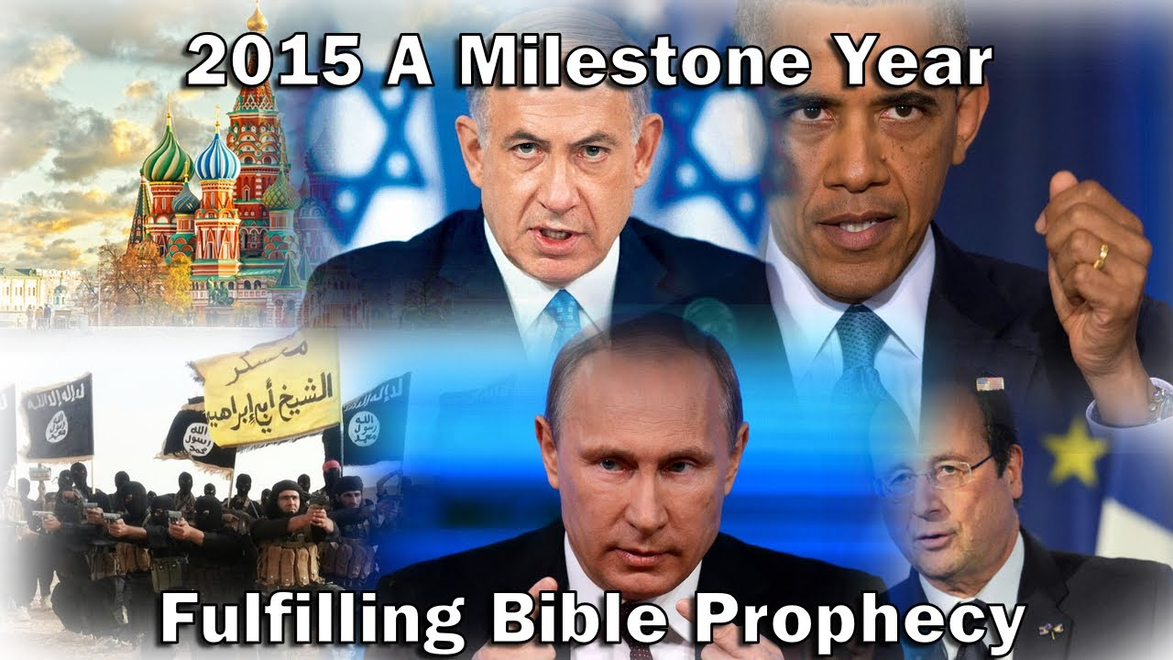
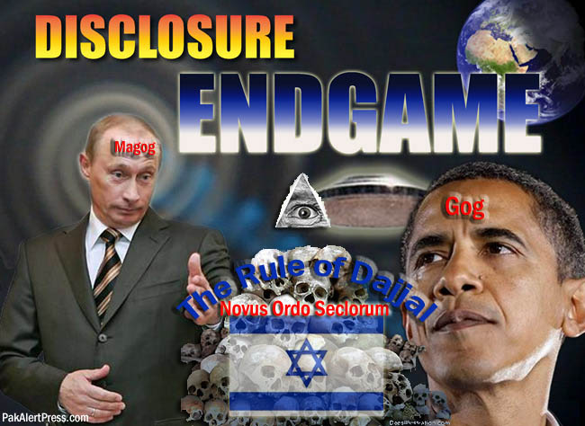
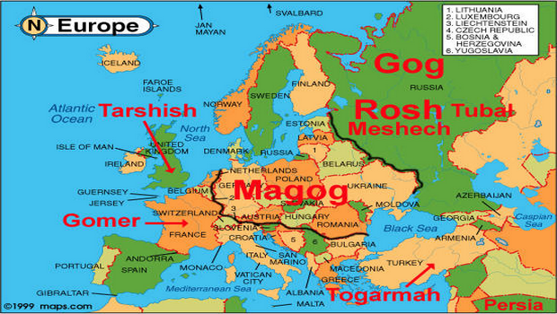
No, no, no… just no.
So much error, specultion and unscriptural thoughts about these chapters, especially by Premillennialists.

Slide 4
Ezekiel 38-39 overview
These chapters are apocalyptic, i.e. highly symbolic and there are great difficulties in taking them literally.
The basic theme is that God will protect His people and destroy their enemies.
“When the thousand years are completed, Satan will be released from his prison, and will come out to deceive the nations which are in the four corners of the earth, Gog and Magog, to gather them together for the war; the number of them is like the sand of the seashore.” (Revelation 20:7-8)

Slide 5
Ezekiel 38: The rescue of the faithful
The Foe (1-2)
Preparations (3-9)
Plans and Motivations (10-13)
Invasion (14-16)
God’s Response (17-23)
"I will magnify Myself, sanctify Myself, and make Myself known in the sight of many nations; and they will know that I am the LORD.”
(Ezekiel 38:23)

Slide 6
Ezekiel 39: results of the victory
Dramatic Destruction of the Enemies (1-8)
Complete Destruction (9-20)
Vindication (21-24)
Final Consolation (25-29)

